Slide 1

Call Center Operations Optimization
A Simulation-Based Approach to Staffing, Cost, and Customer Experience
ZS
by Ziffy Star

Slide 2

Introduction: Balancing Call Center Demands
Cost Efficiency
Minimize operational expenditure
Customer Satisfaction
Ensure positive customer experience
Staffing Optimization
Achieve ideal agent allocation
Machine Learning and simulation provide actionable insights for success.

Slide 3
Problem Statement: The Optimization Challenge
High Wait Times
Overstaffing
Optimization Goal
Leads to customer dissatisfaction and churn.
Drives up operational costs unnecessarily.
Reduce wait times
Minimize costs
Maintain quality

Slide 4
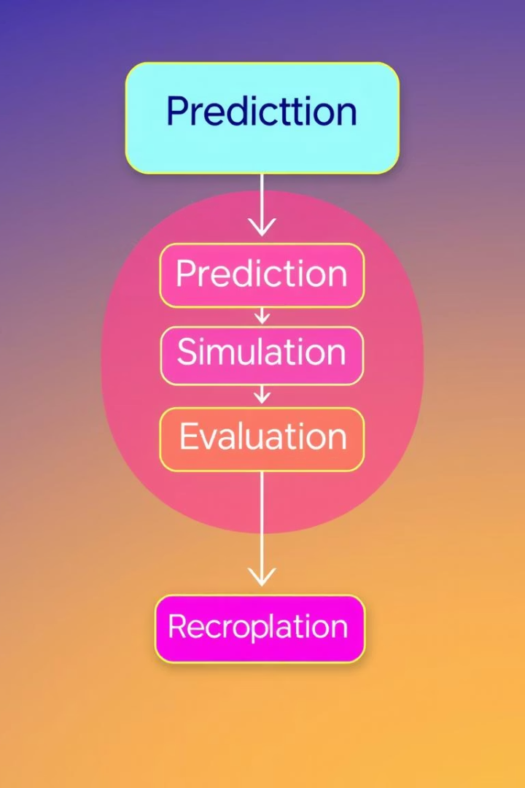




Objectives: Our Simulation-Based Approach
Predict Call Volumes
Leverage ML models for accuracy.
Simulate Scenarios
Test different staffing levels.
Evaluate Impact
Assess wait times, abandonment, service levels.
Recommend Strategies
Provide optimal staffing plans.

Slide 5

Dataset Overview: Foundation of Insights
Data Source
Key Features
Historical call center logs.
Call timestamp
Duration of call
Wait time
Agent ID
Call outcome

Slide 6




Data Preprocessing: Refining the Data
Handle Missing Data
Impute or remove incomplete entries.
Time Series Resampling
Aggregate data to hourly or daily intervals.
Feature Engineering
Create time-of-day and day-of-week indicators.
Label Encoding
Convert categorical fields to numerical format.

Slide 7




Exploratory Data Analysis (EDA): Uncovering Patterns
Weekday/Hourly
Call Outcome Trends
Visualize call volume with heatmaps.
Analyze abandoned vs. resolved calls.
Peak Hours
Seasonal Patterns
Identify busiest times and call distribution.
Detect recurring demand fluctuations.
2
3
1
4

Slide 8




Predictive Modeling: Forecasting Call Volumes
Random Forest
XGBoost
LSTM
Robust for varied feature types.
High performance, gradient boosting.
Ideal for time series forecasting.
Target: incoming calls per time window. Features: historical volume, time indicators, holidays.

Slide 9



Simulation Framework: Discrete Event Simulation (DES)
Queue Length
1
Monitor customer waiting lines.
Customer Wait Times
2
Calculate average and maximum waits.
Abandonment Probability
3
Estimate calls lost due to wait.
Inputs include predicted call volume, average handling time, and agent availability.

Slide 10
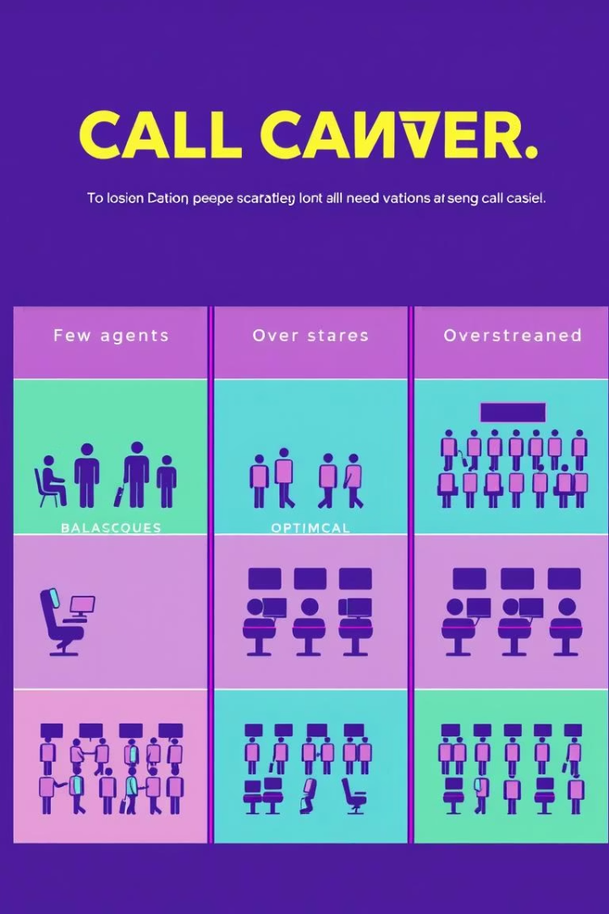
Scenario Analysis: Optimal Staffing Levels
Understaffed
Long
Low
Poor service
Optimal Staffing
Balanced
Balanced
High service
Overstaffed
Short
High
Excellent service
Simulate various staffing levels to measure key performance indicators for each scenario.

